Slide 1
Vibe Check 2024
CIS 6905 Progress Update – September 13, 2024
Deeptika Kannan

Slide 2
What happened last time
Check in with the College of Journalism and Communications
Revised data cleaning pipeline and word cloud generation
Implemented a plan for the Sep 10 Harris vs Trump debate
Discussed the final goal of producing a real-time dashboard with key indicators

Slide 3
What has happened since
Surveyed all networks who were livestreaming the presidential debate on September 10
Initial survey: ABC, NBC News, CNN, CBS, Fox News
Fox News is the only right-leaning network (source: Media Bias Chart)
Further verification done on the day of the debate
Discovered more networks livestreaming the debate, including international ones (~12)
ROADBLOCK: Unfortunately, live chats were disabled and/or limited to authors picked by the network
Finalized on: ABC, NBC News, Fox News, News Max, WFAA, CNN News 18
Fox News, News Max are right-leaning networks (source: Media Bias Chart)
ABC, NBC News, WFAA are left-leaning networks
CNN News 18: international perspective

Slide 4
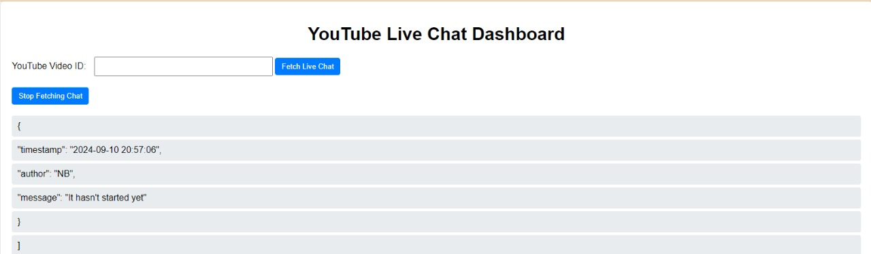
What has happened since
YouTube Live chat scraper
pytchat library used to scrape from multiple streams
Optimized synchronization
Flask-based application for scraper and real-time dashboard
Chats stored in json files

Slide 5
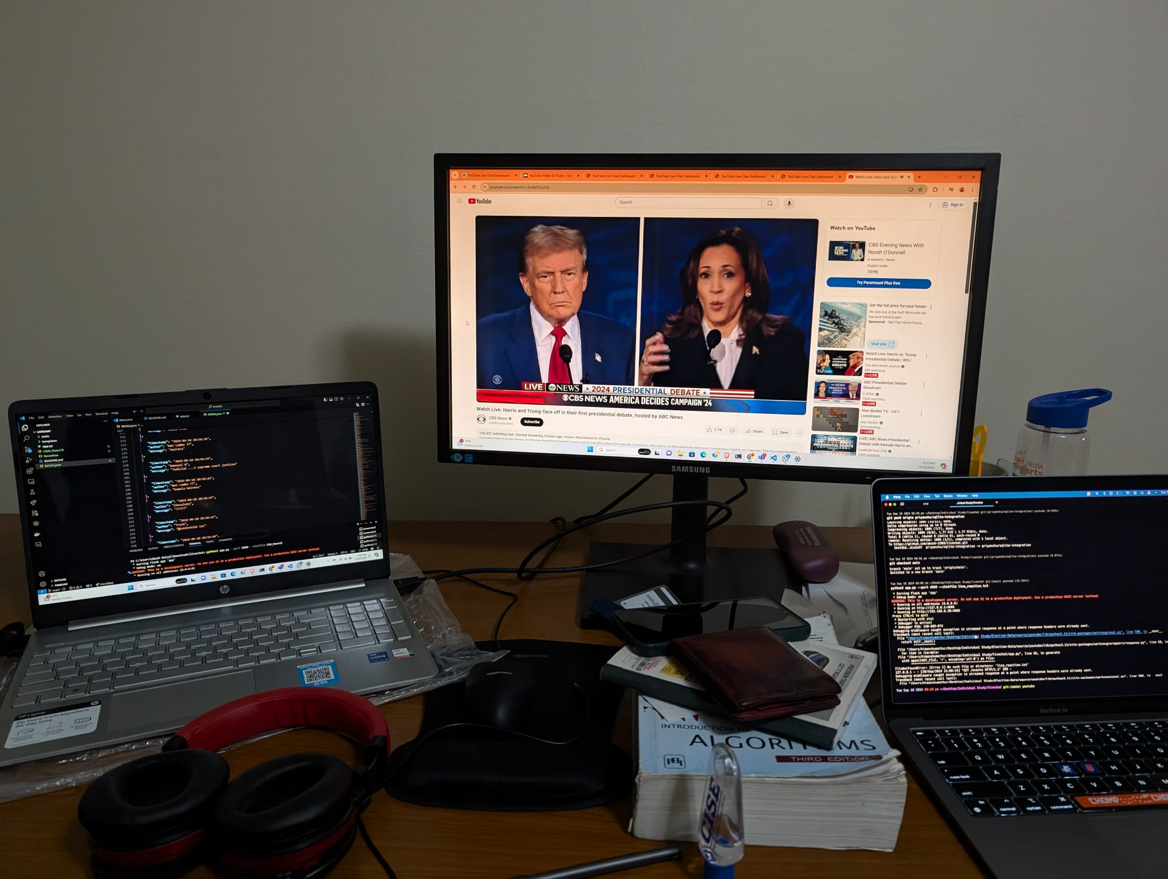
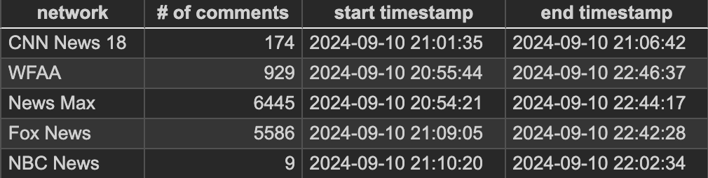
What has happened since
Scrapers were started 20:50. Data summarized as follows:
Note: ABC did not post any live chat comments

Slide 6
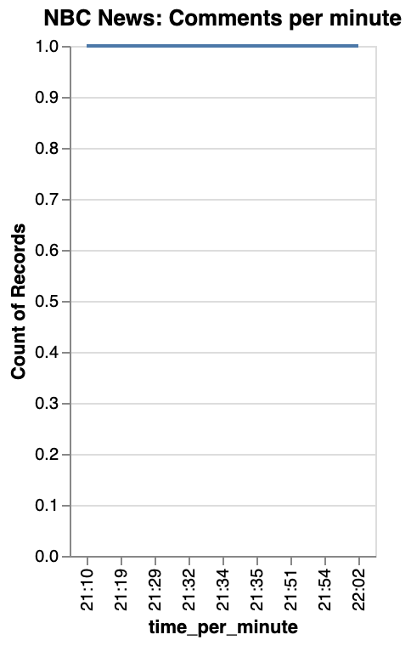
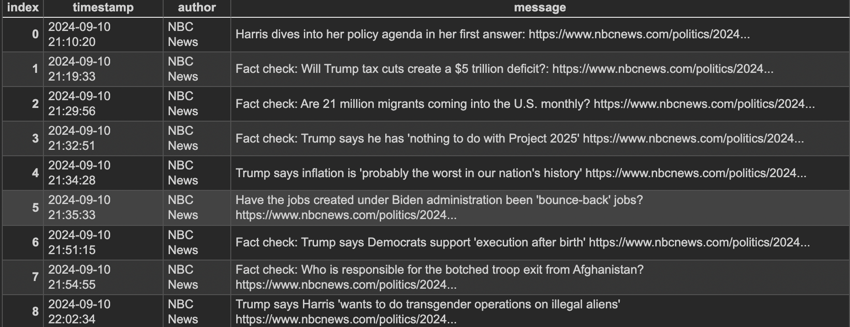
Data Analysis
Initial statistical analysis of data and visualizations
# of comments at each minute
NBC: 9 comments, mostly fact checks from the network

Slide 7
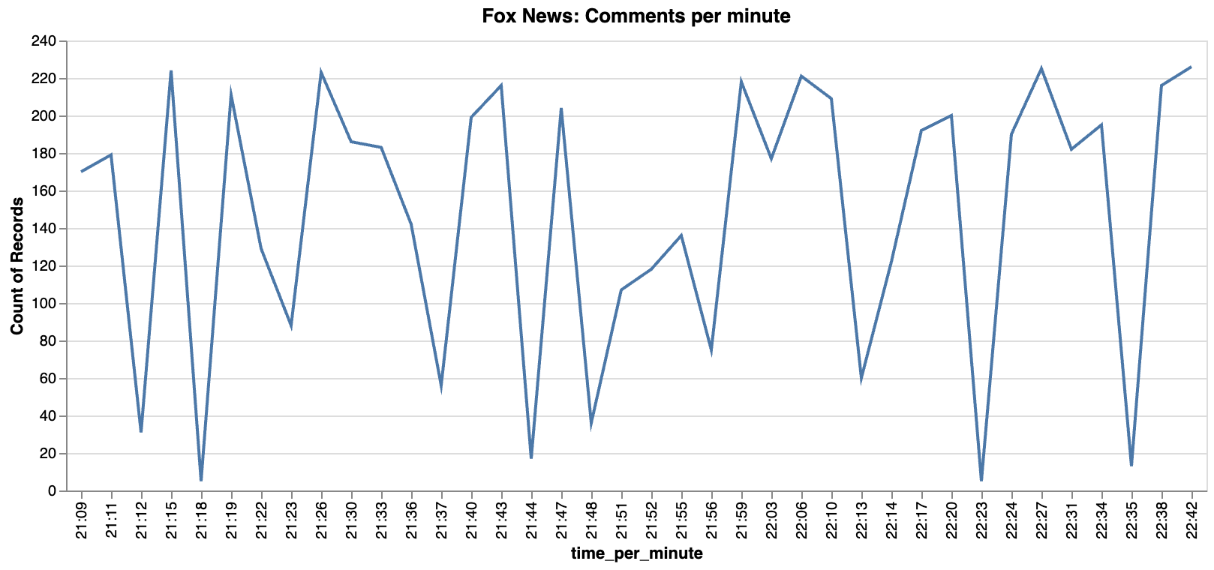
Data Analysis
Initial statistical analysis of data and visualizations
# of comments at each minute
Fox News: 5586 comments

Slide 8
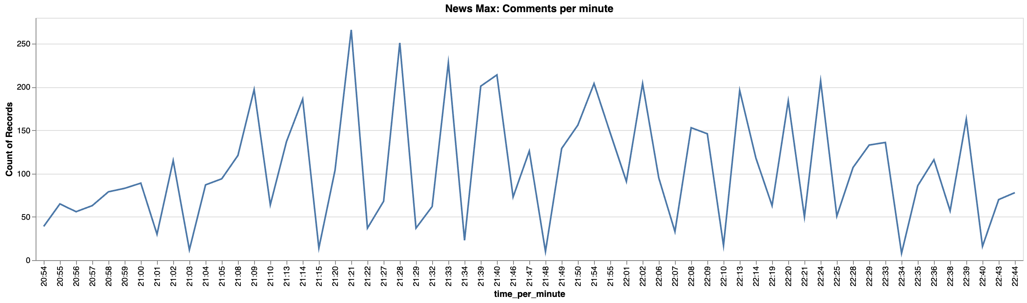
Data Analysis
Initial statistical analysis of data and visualizations
# of comments at each minute
News Max: 6445 comments

Slide 9
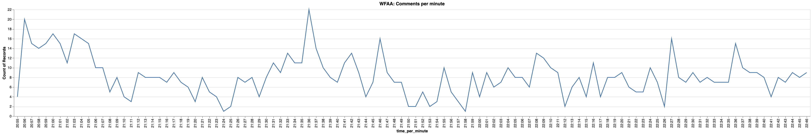
Data Analysis
Initial statistical analysis of data and visualizations
# of comments at each minute
WFAA: 929 comments

Slide 10
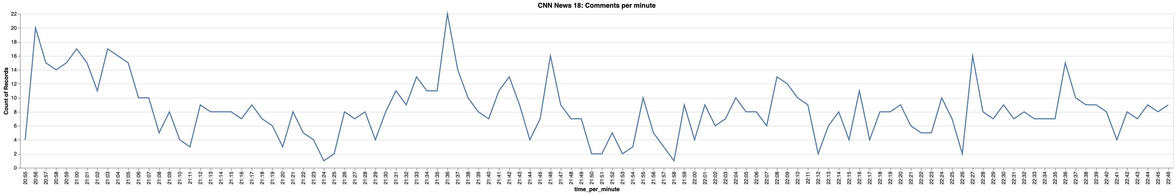
Data Analysis
Initial statistical analysis of data and visualizations
# of comments at each minute
CNN News 18 (International network): 174

Slide 11
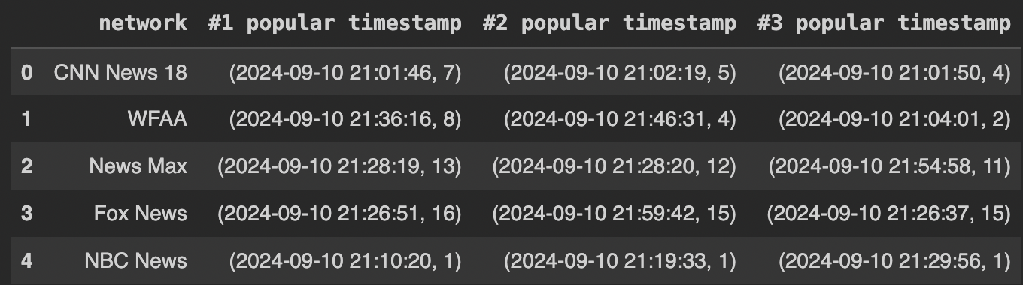
Data Analysis
Popular timestamps
Correspond with transcript with interesting moments in the debate

Slide 12
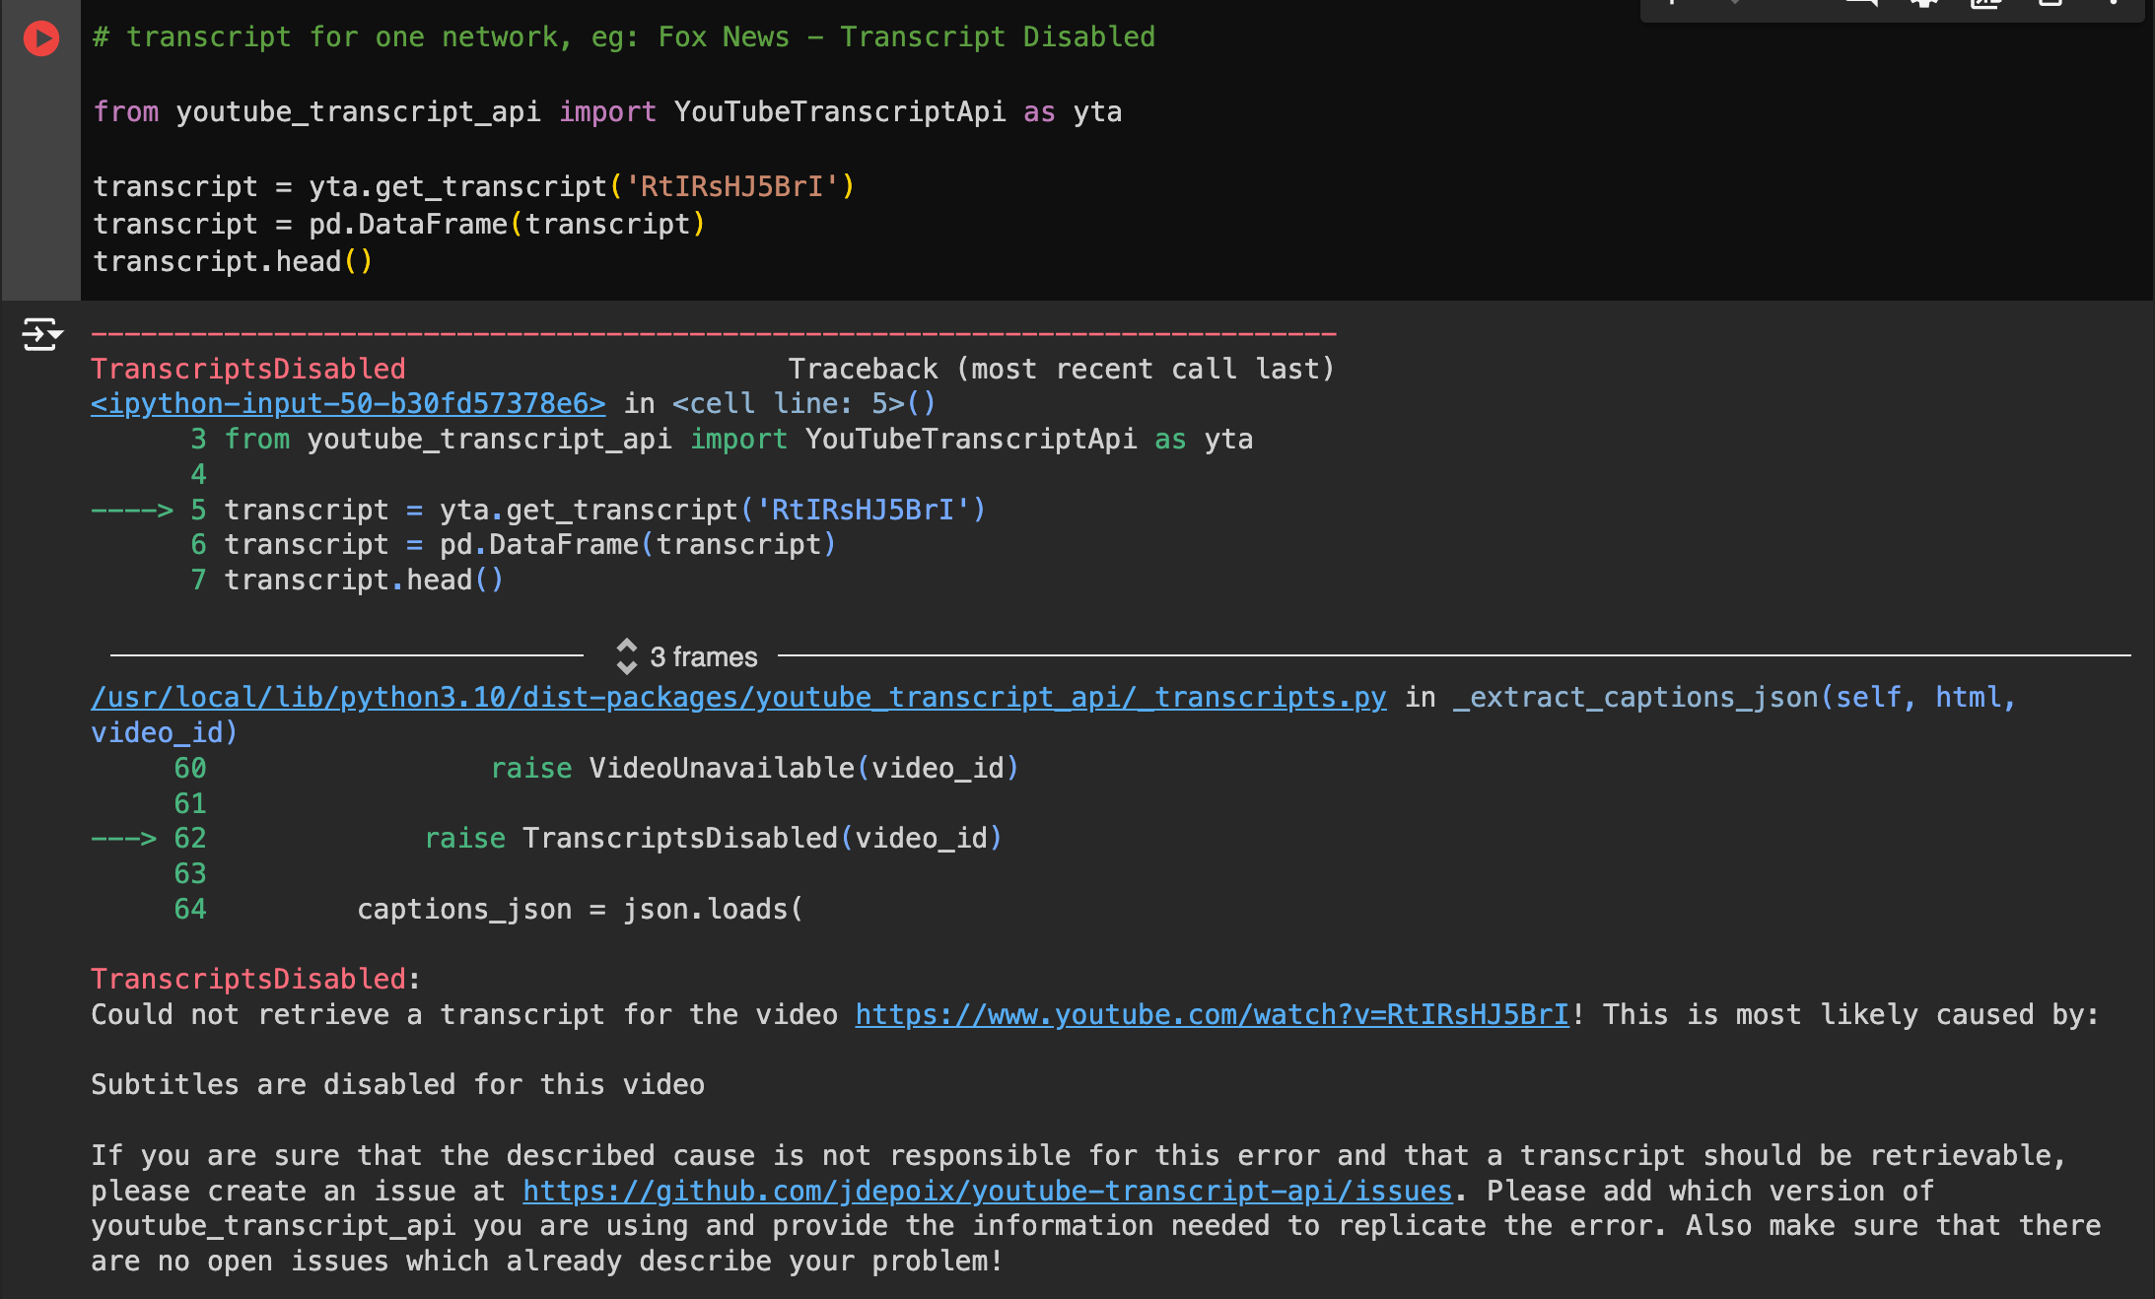
Roadblock
Transcript retrieval: Error
Need to work with YouTube’s automatically generated transcript

Slide 13
Future Plans
Literature Review
Associate chat quantity with transcript
Explore other relationships in the comments such as likes vs text
Contrast both 2024 debates, i.e., Harris vs Trump debate with Biden vs Trump debate

Slide 14
Future Plans
Improved data scraping pipeline, especially for 2024
Use commentThreads() method to iterate and obtain all replies to comments
Preserve and analyze all data scraped, including metadata
Collect video transcripts
Expand video sources for 2020 and 2024 debates
Perform word cloud and additional analysis of pre-election comments in 2020
Explore relationship between likes and comment text
Game plan for September 10 live data scraping?
What are the key indicators?

Slide 15
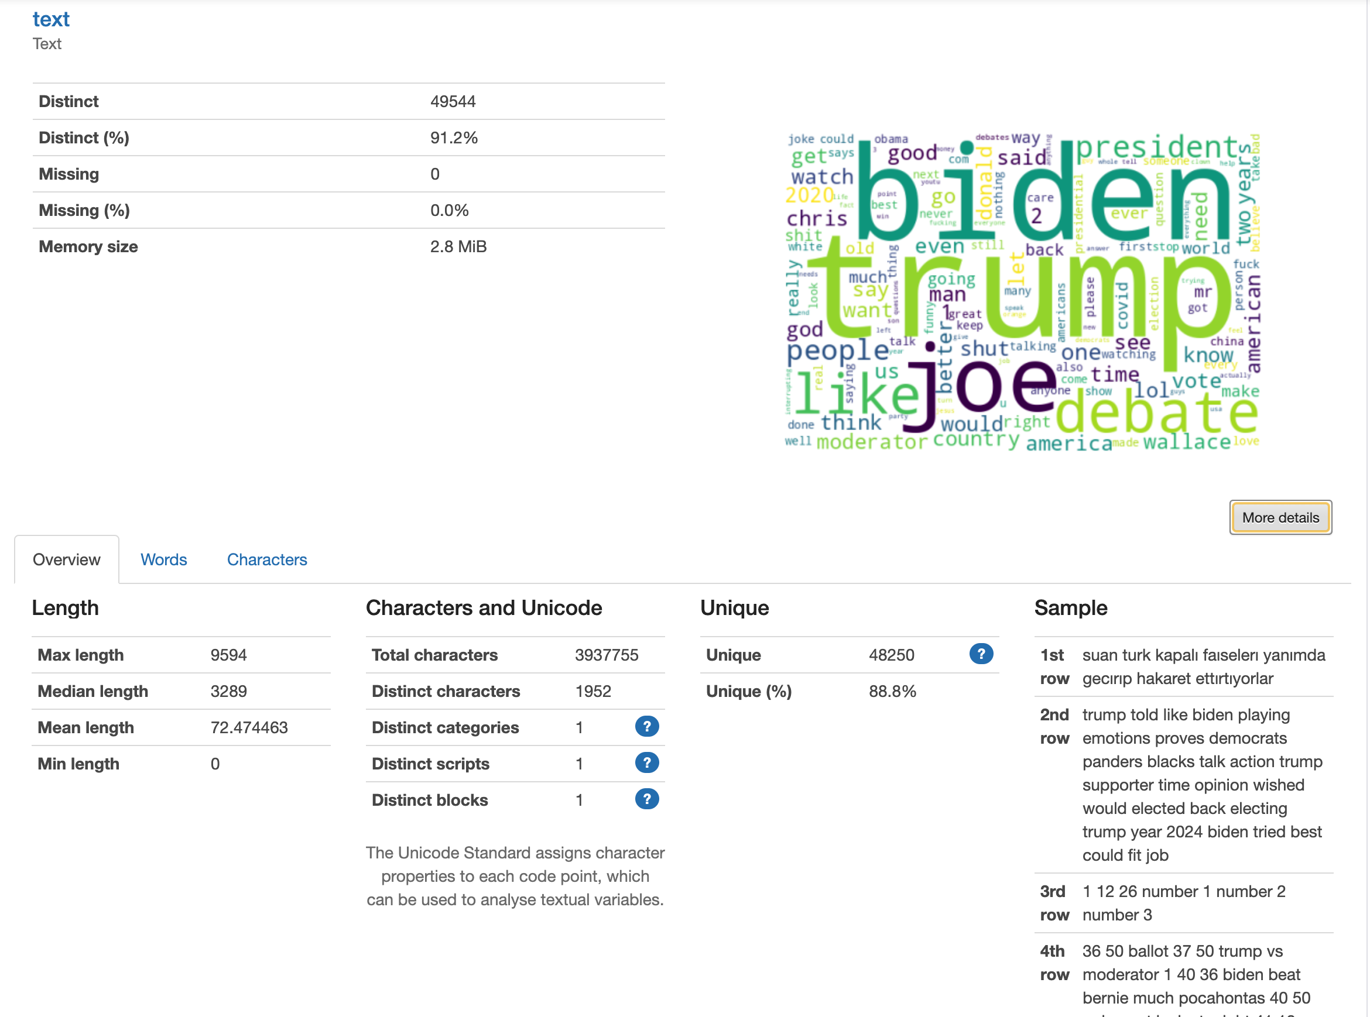
2020 C-SPAN Word Cloud

Slide 16
2024 Wall Street Journal Word Cloud

Slide 17
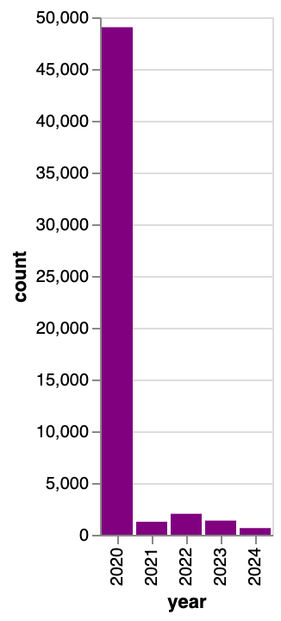
2020: Time period of data collection
Comments over 2020-2024

